Slide 1
Team A
Project 6X6 Tic Tac Toe Game
By Ibra, Eddie, Jason, Carrie, Alexis, Alfonso

Slide 2
Introduction
Tic Tac Toe is a game that is played with two players, X and O, who take turns marking spaces usually in a 3X3 grid.
For this project the game will be change from its most common size 3x3 to a 6x6 with 4 squares require to win rather than 3.
In conclusion it will be 6X6X4 version of the classic Tic Tac Toe game.

Slide 3
Requirement of the project
For the requirement, we interviews the client to set the specification for the project
According to our client, the requirements are as follow:
Users should be able to play the game offline
Users should be able to sign up
Users should be able to play as guest
Users should be able to reset their password

Slide 4
Requirements
Game should be played in offline and accessible to public
Game should allow players to view their history
Game should keep track of players turns and display who is playing with who
Games should be not have a downtime

Slide 5
Functional Requirements
The functional requirements will be determine through multiple use cases:
Register a player
Login as an existing player or a guest
Single player or PvsP
Single player vs AI

Slide 6
Registering a player
For the users to register, certain procedures must take places.
Username must be chosen
A password as well
User information will be saved

Slide 7
Registering a player diagram

Slide 8
Login
For a user to login, these steps are require:
Enter username
Enter password
Database checks if user exist
If user exist, it will allow them to log in
Displays error message “wrong username or password”
Keep asking until the user enters the correct information

Slide 9
Login Diagram

Slide 10
Quitting the game
If the player decided to quit the without the game ending:
That rounded will count against
Players score will be updated on the record
And also give the option to play again or quit the application

Slide 11
Determining winners
The way the game determine who is the winner:
After all squares has been filled
Game performs a search algorithm to check for connected square:
Vertically
Horizontally
diagonally

Slide 12
Determining the winner
The player with the most connected 4 squares wins the game.
Score gets updated on the database
Player is given option to play again or quit.

Slide 13
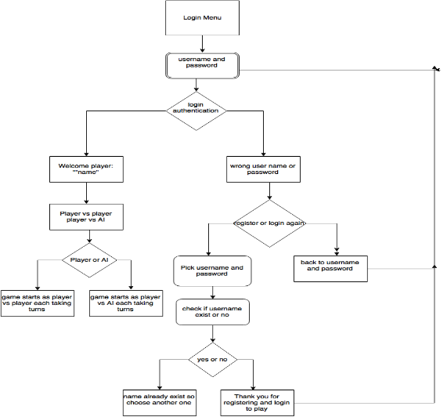
Game flow diagram

